Slide 1
Secure Socket Layer (SSL)

Slide 2
SSL
An industry standard security technology for establishing an encrypted link between a web server and a browser
A certificate is required to established a trust. Web server requires an SSL certificate to create secure connection

Slide 3
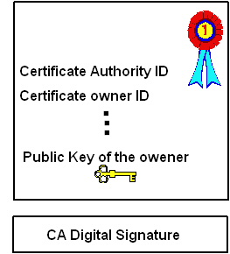
SSL Certificate
Contains a public key of the owner
Certificate owner ID
Name of the issuer
Signature of the Certificate Authority

Slide 4
How to get the digital SSL Certificate
To get a certificate, you must create a Certificate Signing Request (CSR) on your server
This process creates a private key and public key on your server
The CSR file that you send to CA only contains public key
CA checks the identity of the sender, puts a stamp (digital signature) on the certificate and send it back to the owner
Once you get the certificate, you have to install it on the server

Slide 5
How SSL certificate works
When a browser attempts to access a website that is secured by SSL, the browser and the web server establish an SSL connection using a process called an “SSL Handshake”
three keys are used to set up the SSL connection: the public, private, and session keys
Public key algorithm is only used during SSL handshake to create symmetric key. All transmitted data is encrypted using symmetric session key

Slide 6
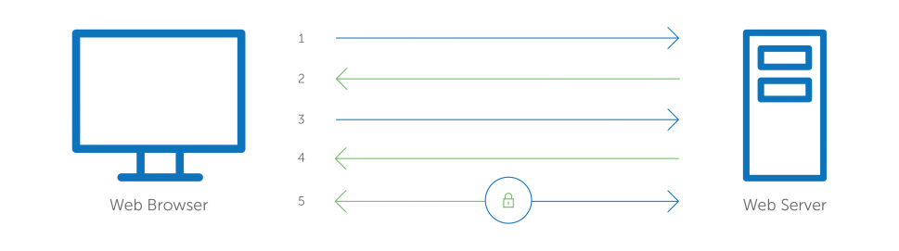
Browser connects to a web server (website) secured with SSL (https). Browser requests that the server identify itself
Server sends a copy of its SSL Certificate, including the server’s public key
Browser checks the certificate root against a list of trusted CAs and that the certificate is unexpired, unrevoked, and that its common name is valid for the website that it is connecting to. If the browser trusts the certificate, it creates, encrypts, and sends back a symmetric session key using the server’s public key
Server decrypts the symmetric session key using its private key and sends back an acknowledgement encrypted with the session key to start the encrypted session
Server and Browser now encrypt all transmitted data with the session key

Slide 7
SSL vs TLS
TLS (Transport Layer Security) is the newer version of SSL
SSL 2.0 and SSL 3.0 were released
SSL 4.0 is referred to as TLS

Slide 8
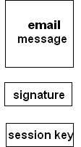
Private/Public Key Mechanism
  Example: PGP (Pretty Good Privacy)
6. verify the signature using the sender’s public key
1. signed with the sender’s private key
5. decrypted with the session key
2. encrypted with the session key
3. encrypted with the recipient’s public key
4. decrypted with the recipient’s private key

